Slide 1
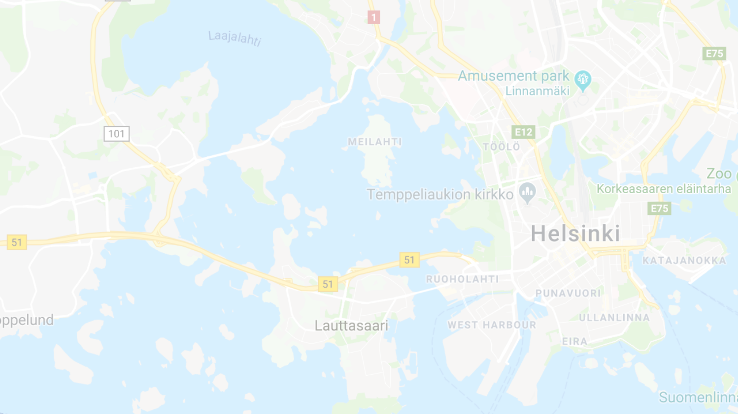
Pasila
Aalto Yliopisto
1
145
Kamppi
Senaatintori

Slide 3
5

Slide 4
7
5
3

Slide 5
7
105
5
3

Slide 6
11
7
55
105
5
3

Slide 7
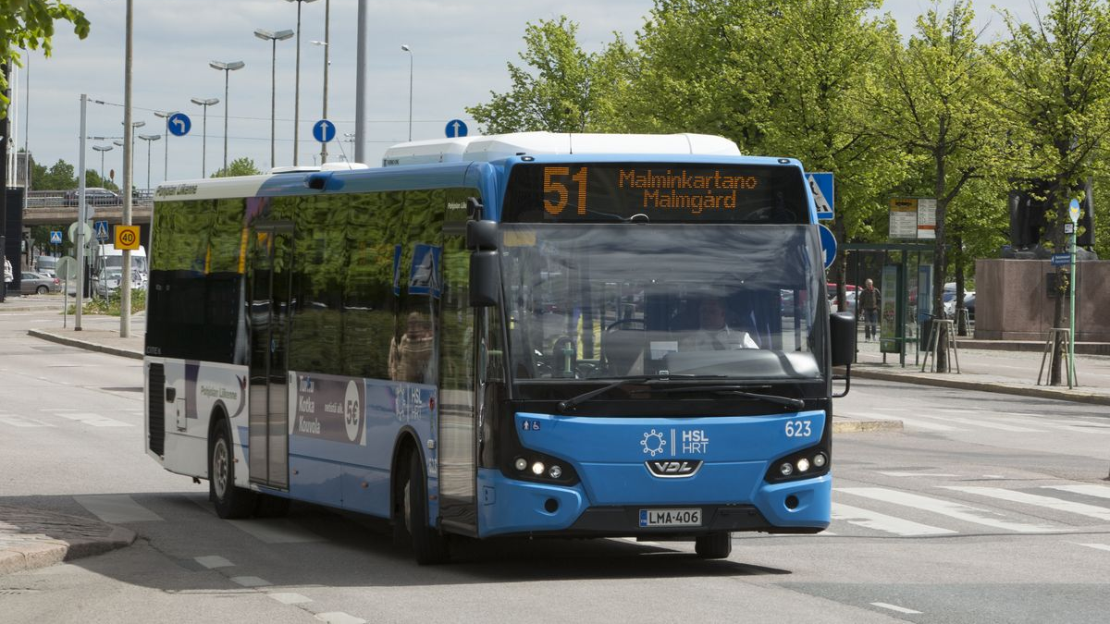

Slide 8
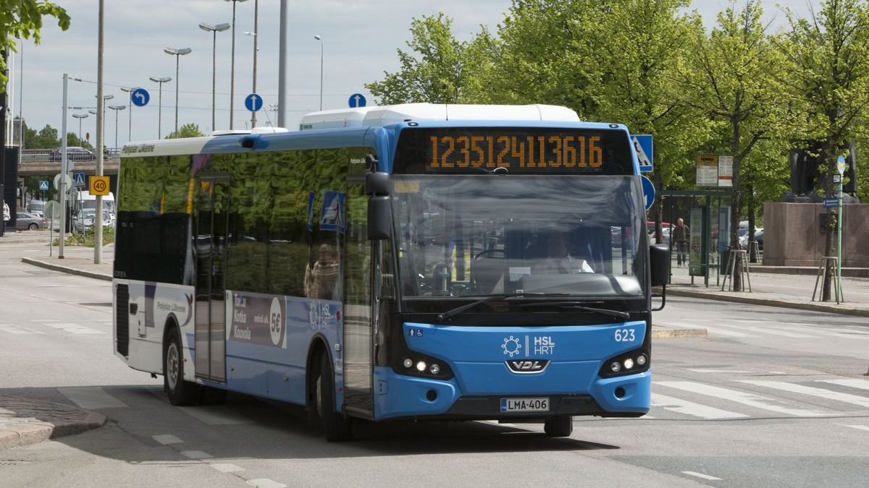

Slide 9
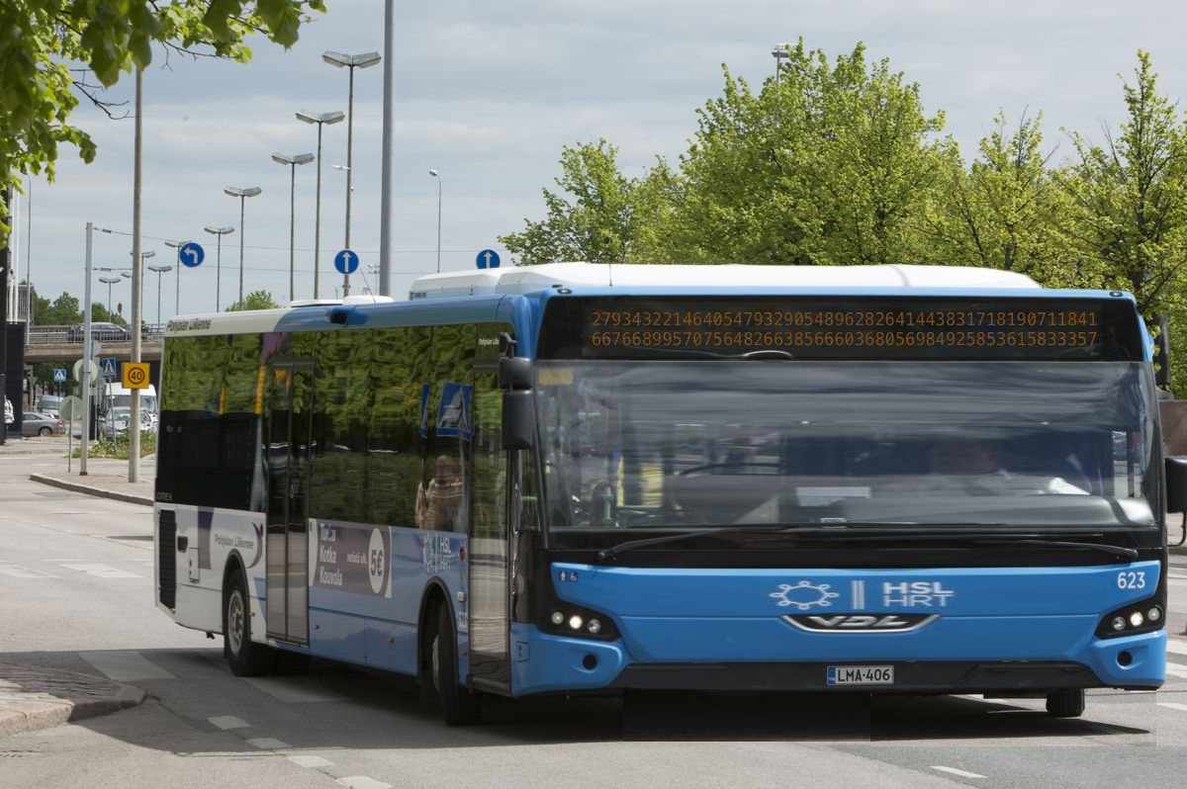

Slide 13
Huge Number
Huge Bus
Difficult to read

Slide 14
Basemoji

Slide 15
Re-define Bus Numbers

Slide 16
Dynamic Basemoji RouteProducts

Slide 17
Let’s Imagine a World with Dynamic Basemoji RouteProducts

Slide 18
Reittiopas (but wait, you wouldn’t actually need to do that)
Bus stop icons
Catching a bus
Inside a bus, checking when to get off
Calling a friend to say which bus you’re on
Screwed if you have to change lines
Screwed if you don’t know the stationCode before hand
Screwed if you can’t do division

